Slide 1
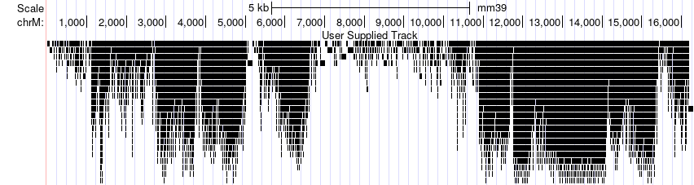
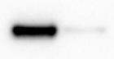

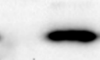

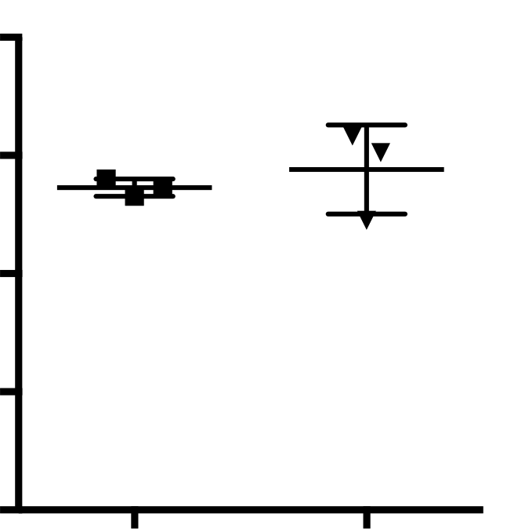
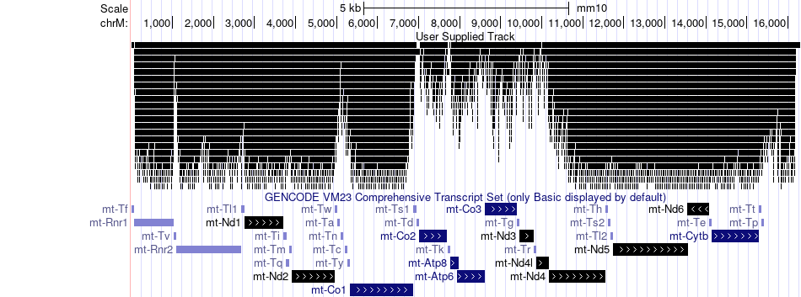
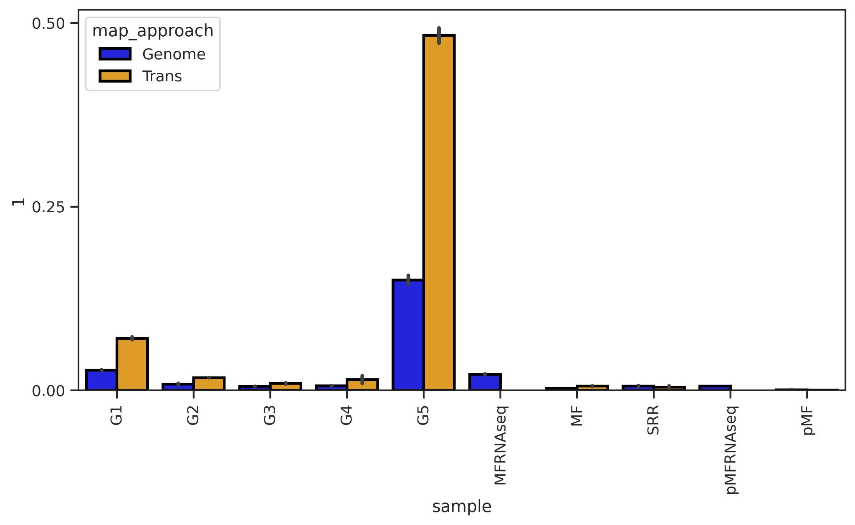
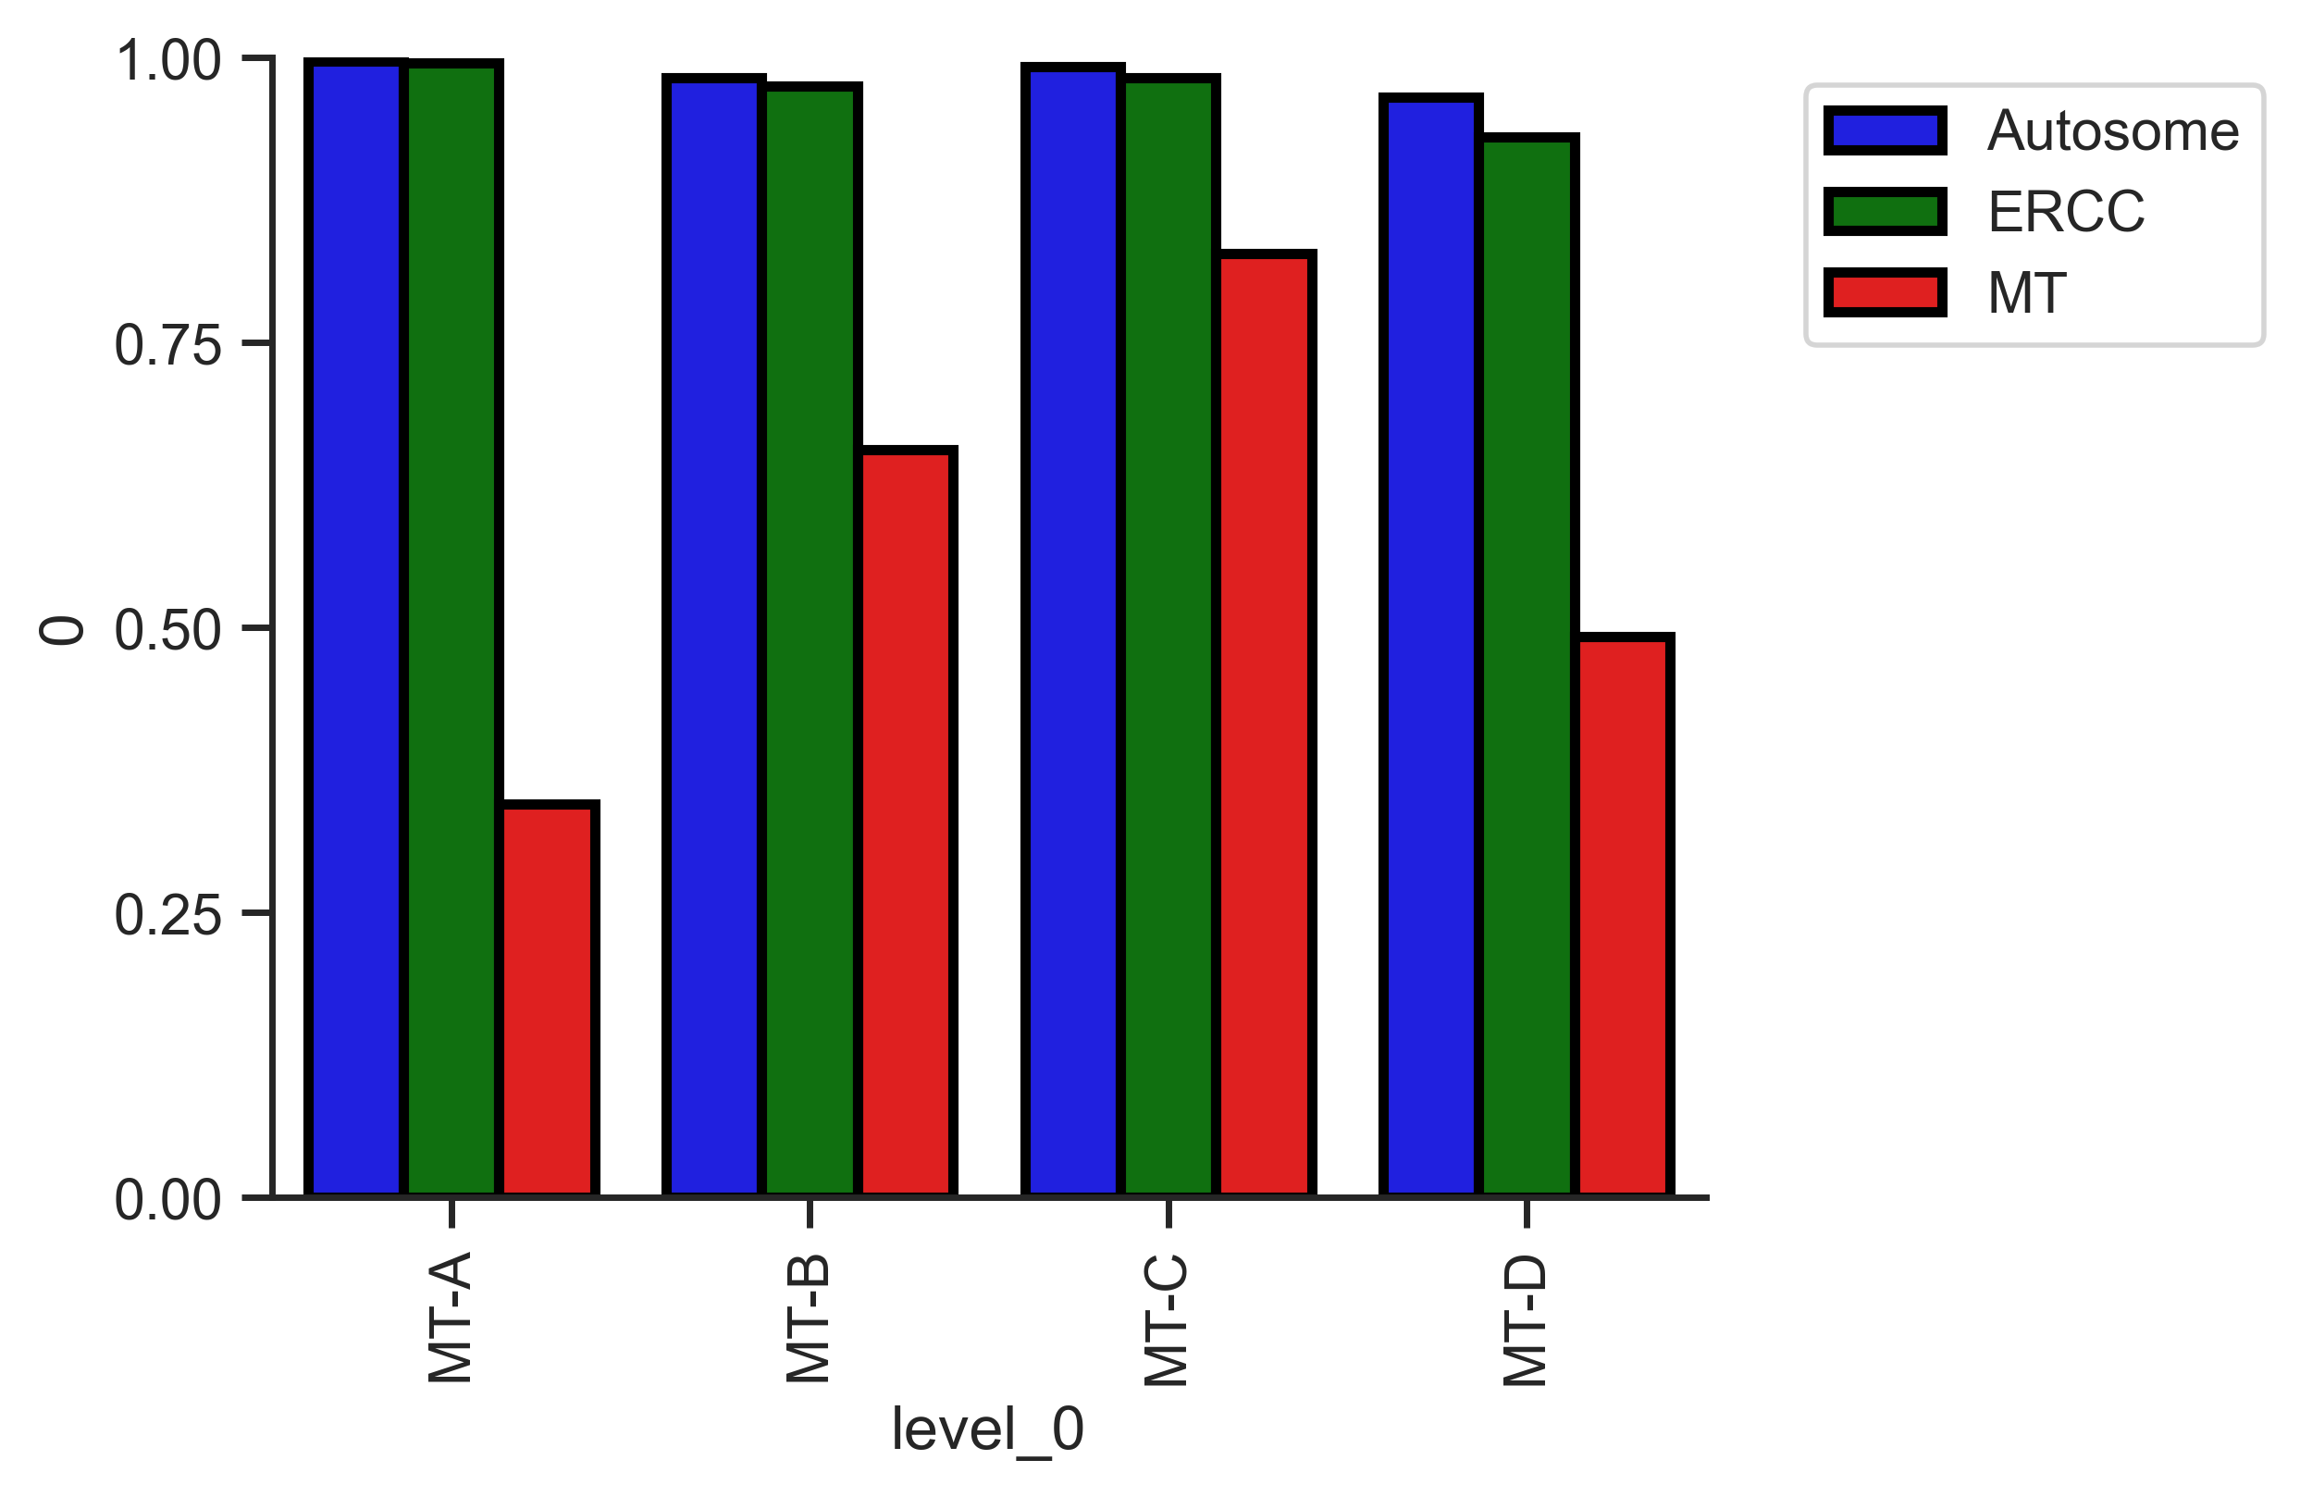
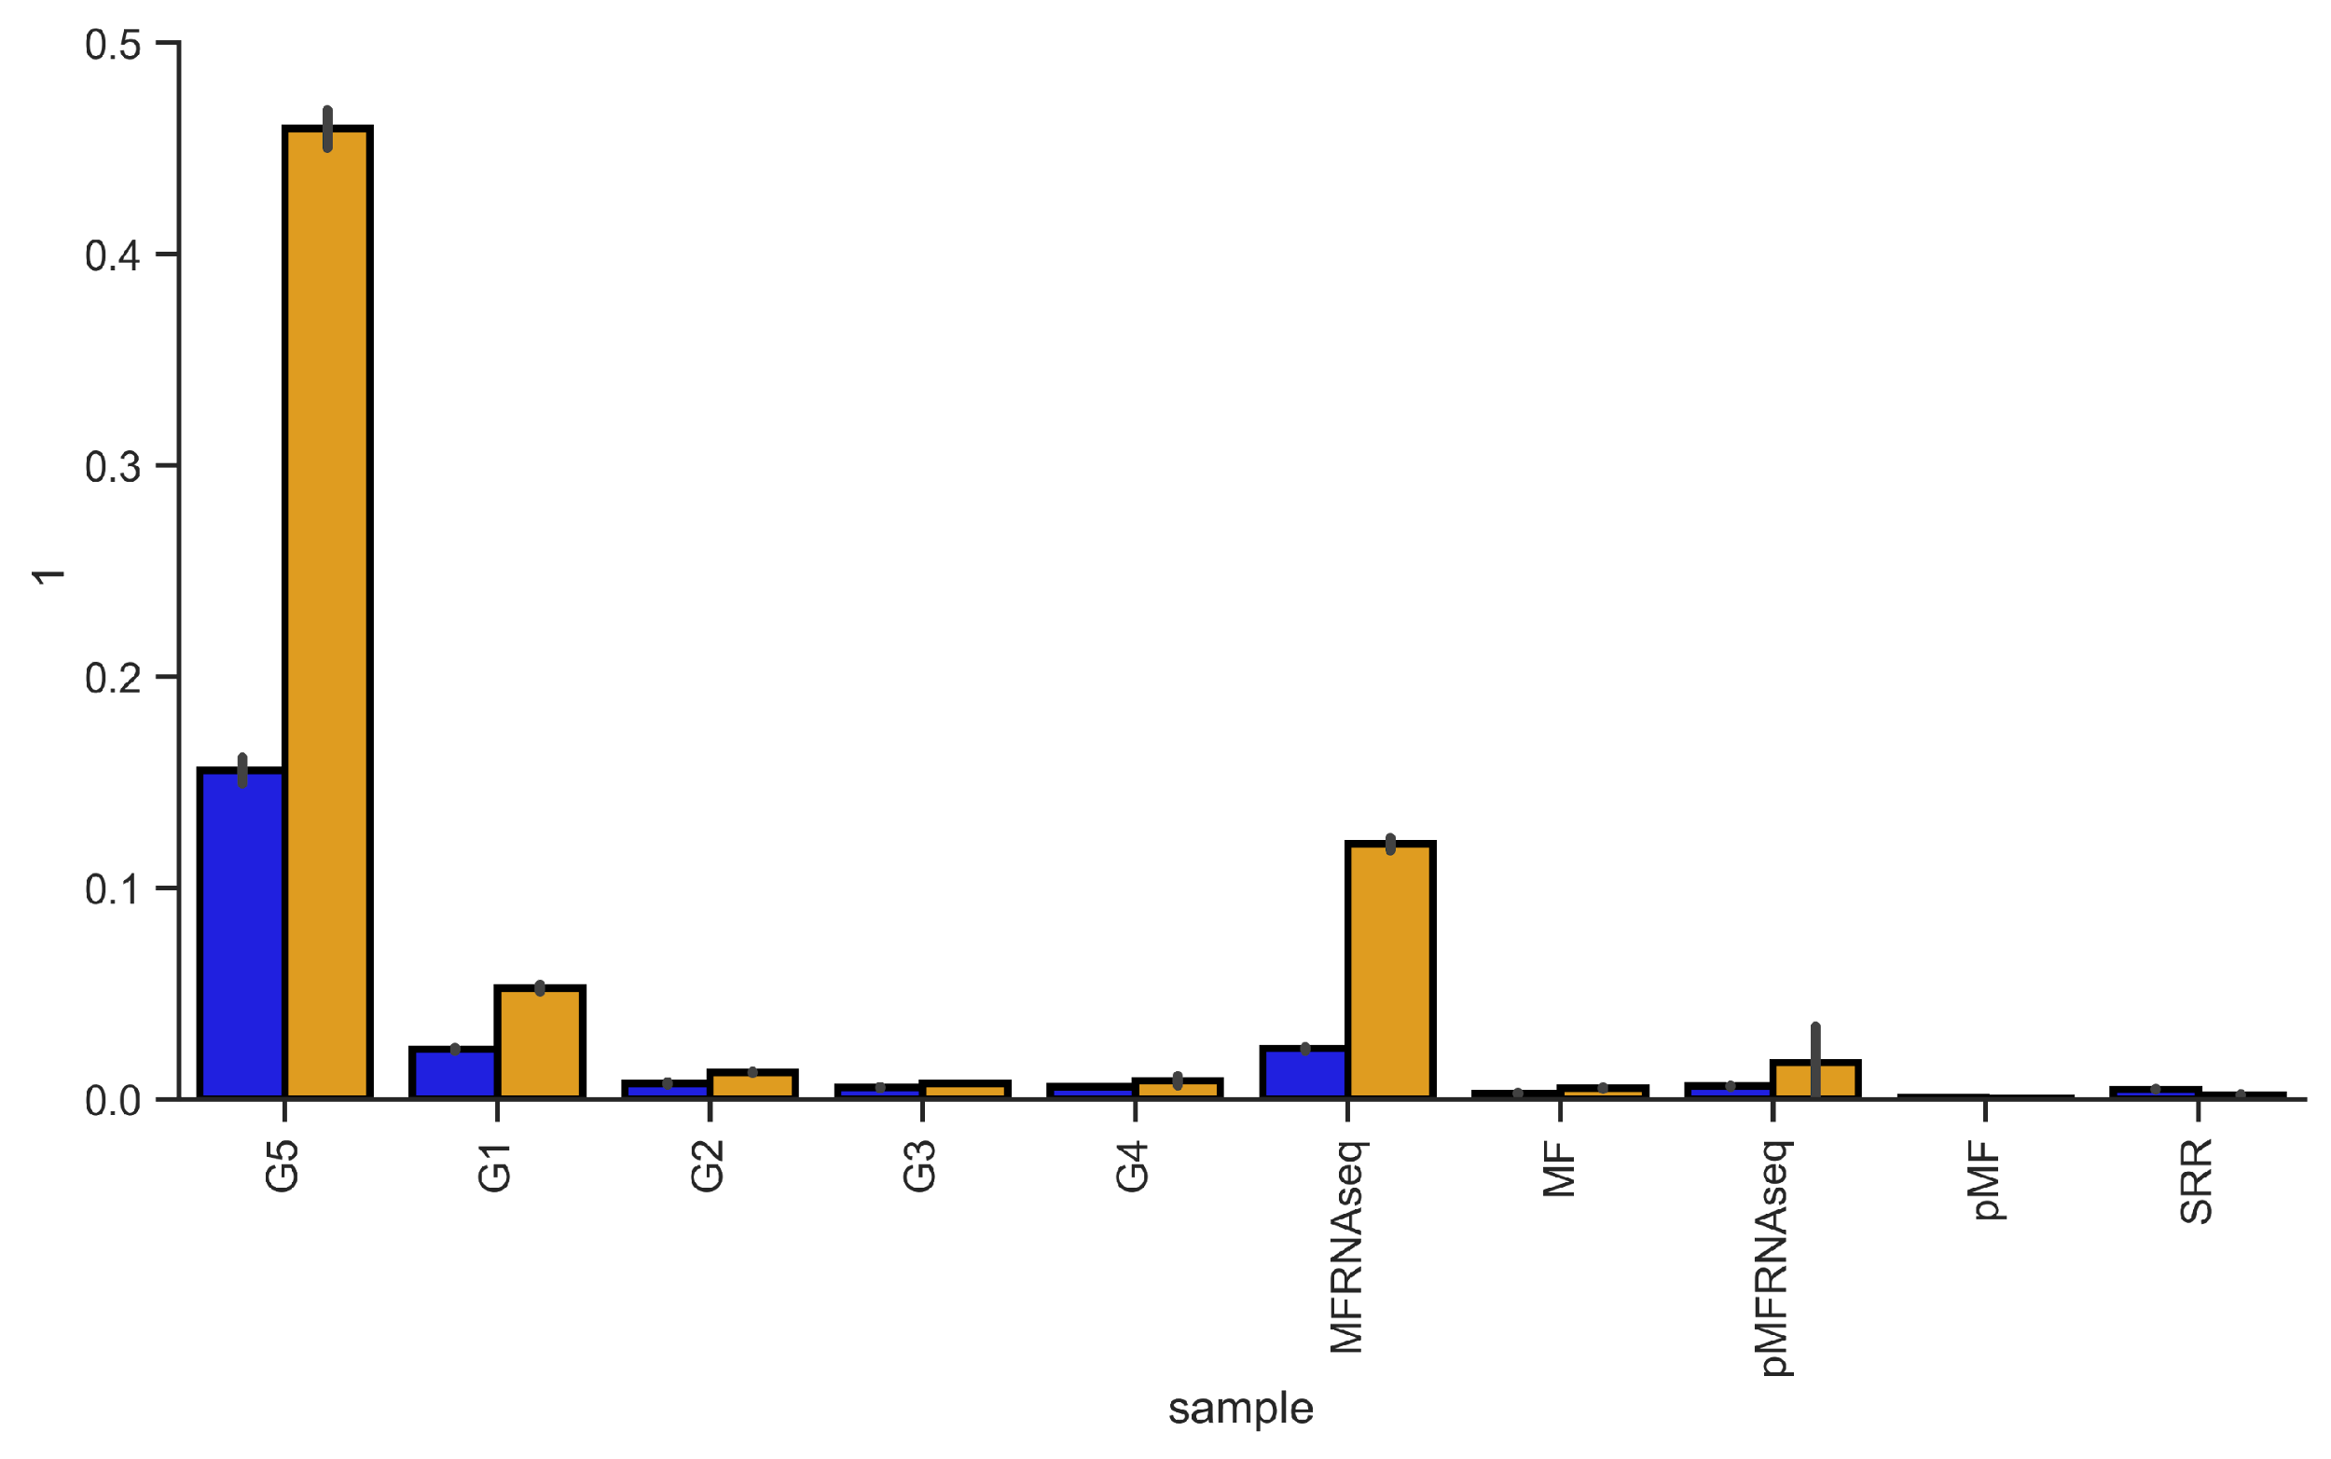
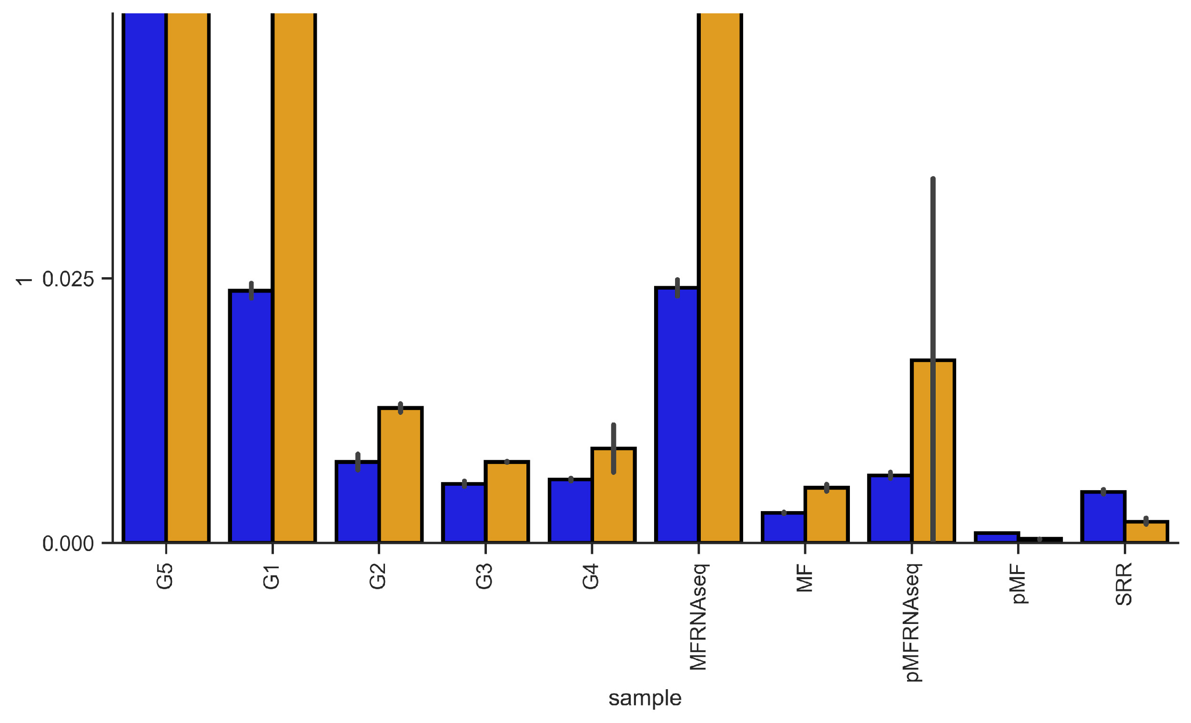
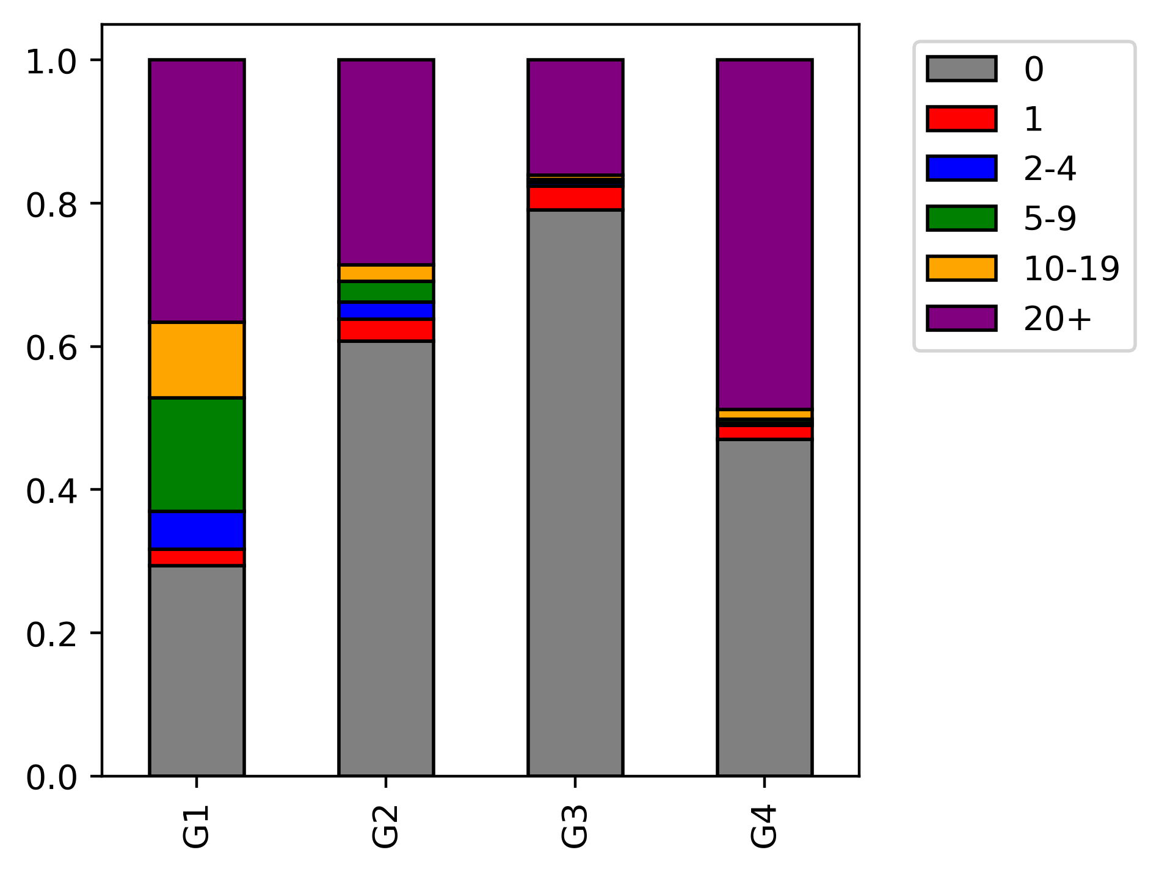
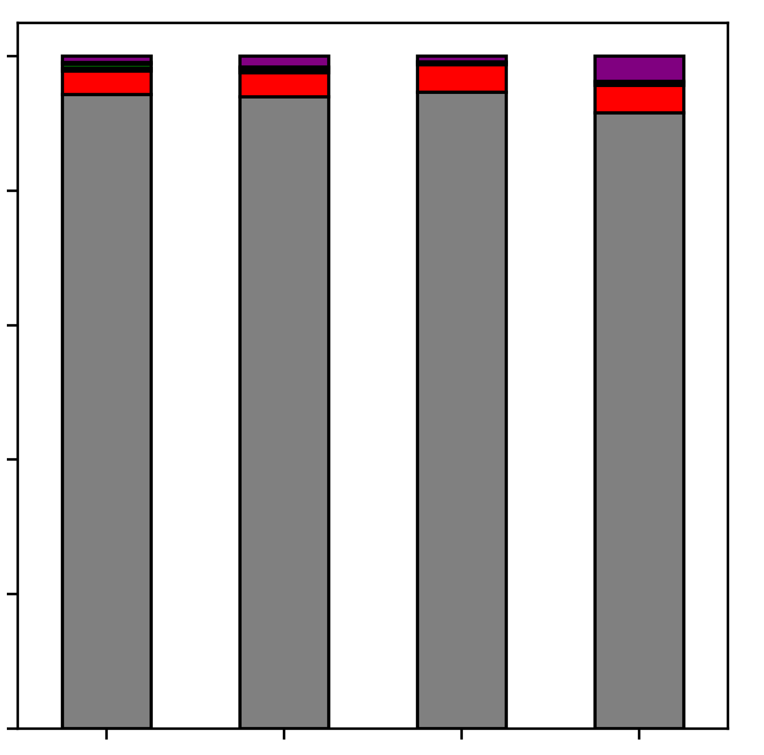
A
C
Huang
Cyto rep1
Cyto rep2
MT rep1
MT rep2
GAPDH
COX IV
B
Mitochondrial RNA BS-seq
120
n.s.
90
Fold Enrichment
(mt-Nd1)
60
30
0
MT
rep1
MT
rep2
D
E
Nuclear
meRanGh (Genome)
ERCC
50%
30%
10%
2.5%
0%
meRanT (Transcriptome)
Mitochondrial
Reads mapped to MT chromosome
Retained reads after 3C filter
MT-A
MT-A
MT-B
MT-C
MT-D
MT-B
MT-C
MT RNAseq
MT-D
Huang
F
Reads mapped to
mitochondrial chromosome
Reads mapped to
nuclear chromosomes
1.0
0.8
0.6
0.4
0.2
0.0
p-m⁵C sites
Proportion of reads
MT-A
MT-B
MT-C
MT-D
MT-A
MT-B
MT-C
MT-D
Figure 5. Interrogation of bisulfite preparation conditions used in mitochondrial libraries (A) Western blot of mouse NSC cell fractions representing cytosol and mitochondrial structures. GAPDH was used as a marker for cytosol, while COX IV was used as a marker for the mitochondria. (B) qPCR assay of mt-Nd1 in mitochondrial fractions. Bar indicates mean and S.E.M of biological replicates. (C) Read pile-up visualization of a representative Huang and Mitochondrial RNA library using the UCSC genome browser. Peaks are scaled according to max peak height for each library. Gencode gene annotations are displayed below. (D) Proportion of reads mapped to the mitochondrial chromosome using meRanGh (genome mapping) and meRanT (transcriptome mapping) for all RNA BS-seq and RNA-seq libraries. Replicates are merged, error bars represent standard deviation. (E) Mapped reads retained after a read C-cutoff of 3 for mitochondrial libraries. Non-mitochondrial (blue), ERCC (green), and mitochondrial mapped reads (red) are distinguished by color. (F) Number of p-m⁵C sites contained in each read, binned by p-m⁵C content. Reads are separated by mapping to the mitochondrial chromosome (left) and all other canonical chromosomes (not including control sequences) (right).

